Slide 1

MIS 665 Final Presentation
Matt Cornell

Slide 2
Project Description
Business problem: For the sport’s marketing analytics competition, I was given a data set that I needed to analyze to determine who will renew for a season ticket for the next year
To analyze and determine who will renew a season ticket, I used data normalization, visualization, exploratory data analysis, model building, and model selection on the dataset

Slide 3
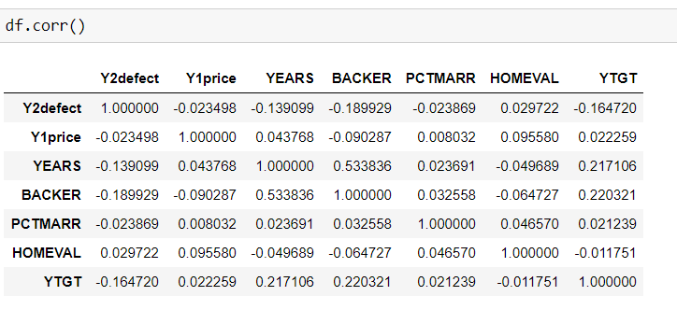
Analysis
Key findings from data visualization and data analysis
One of my hypothesis was the following, my null hypothesis is that there is no significant difference for the amount of games a person goes to affects if people chooses to renew a season ticket for the next year
After testing the hypothesis, I found that I would end up rejecting the null hypothesis
When I did data correlation, I found that some of the columns I had were correlated to the combined column of the each game a person could go to.

Slide 4
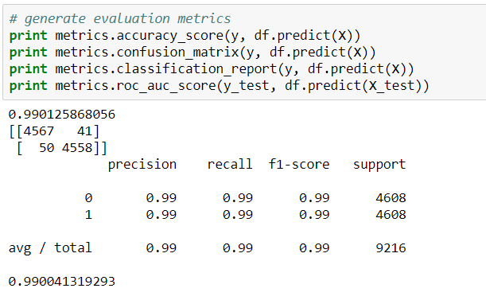
Analysis continued
From the model development, I found that my random forest was my best model.

Slide 5
Storytelling
Who is likely to renew “season ticket”?
The people who are likely to renew season tickets are people who going to still be in the area, don’t mind the current price, within an age range, and have good income
Who is likely to defect?
The people who are likely to defect are people who didn’t go to many games, no longer live in the area,
Recommendations for the athletic department
I would recommend that the athletic department look at factors that might affect a person's decision to renew such a person's location, team's stats for wins and losses, and opposing team.

